Slide 1
PISA for Development
Three issues with target populations
Low level of lower secondary school completion rates
High percentage of over-age students
Low level of literacy among those dropping out after 5-6 years

Slide 2
High probability that 15-year-olds are out-of-school
Lower secondary school completion rate
Senegal (2010 DHS): 15%
Cambodia (2010 DHS): 34%
Zambia (2007 DHS): 40%
Net secondary school enrolment rate
Guatemala (2011 ENCOVI): 44%
Ecuador (2011 EESD): 79%

Slide 3
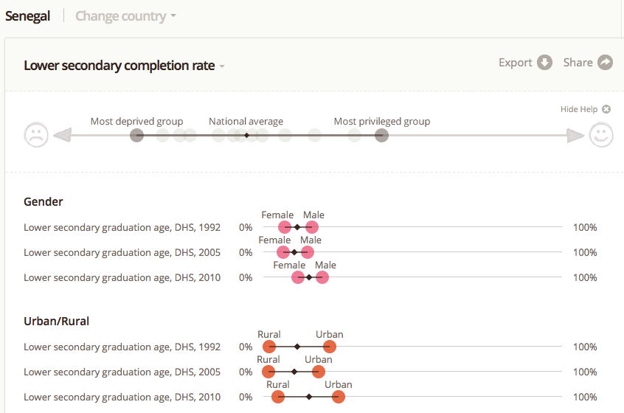
Senegal

Slide 4
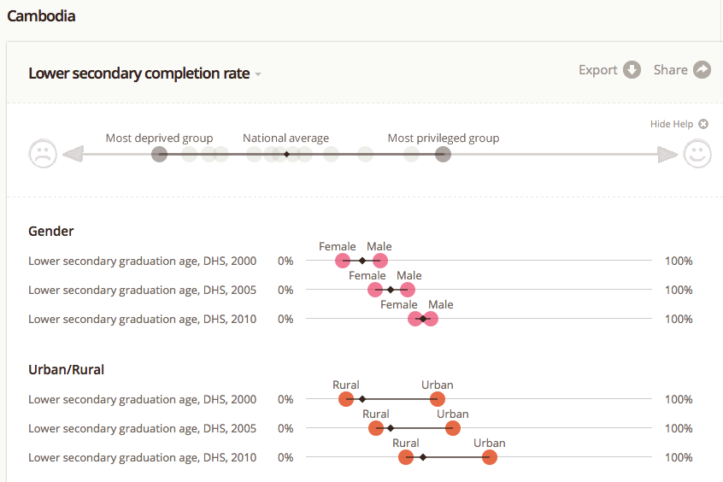
Cambodia

Slide 5
High probability that 15-year olds are not in the expected grade
Percentage of primary school age children who are at least two years older than expected for their grade
Zambia (2007 DHS): 50%
Cambodia (2010 DHS): 42%
Senegal (2010 DHS): 14%

Slide 6
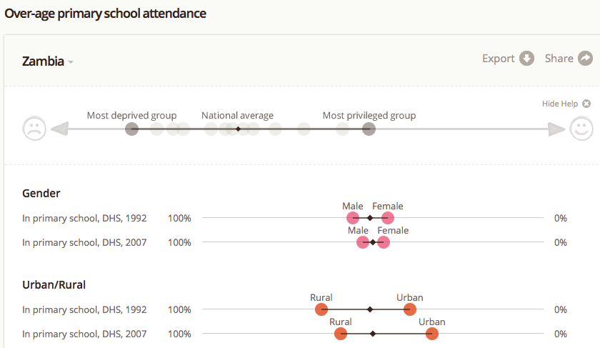
Over-age students
Zambia

Slide 7
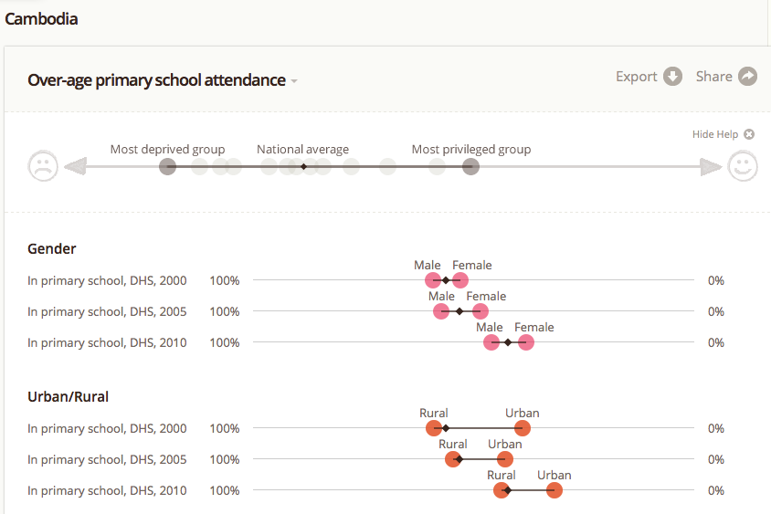
Over-age students
Cambodia

Slide 8
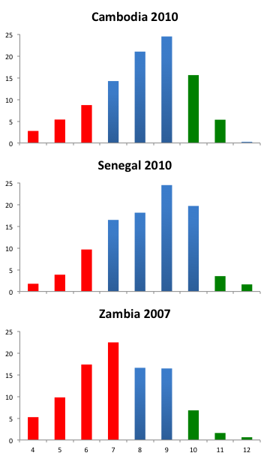
Over-age students

Slide 9
Literacy of dropouts
Literacy rate after 5-6 years of school
Zambia (2007 DHS): 41%
Senegal (2010 DHS): 48%
Cambodia (2010 DHS): 56%

Slide 10
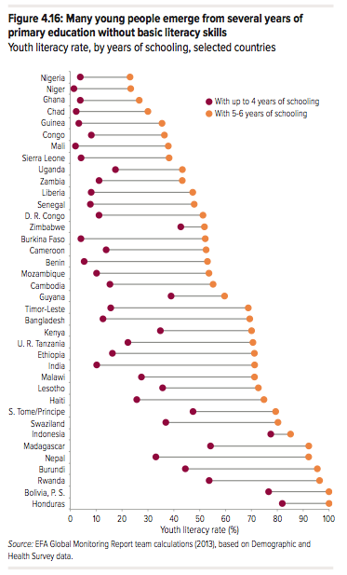
Literacy of dropouts

